Slide 1
Creating Procedures
Notes:
Schedule: Timing Topic
60 minutes Lecture
60 minutes Practice
120 minutes Total

Slide 2
Objectives
After completing this lesson, you should be able to
do the following:
Distinguish anonymous PL/SQL blocks from named PL/SQL blocks (subprograms)
Describe subprograms
List the benefits of using subprograms
List the different environments from which subprograms can be invoked
Notes:
Lesson Aim
PL/SQL supports many different program constructs. In this lesson you learn the difference between anonymous blocks and named PL/SQL blocks. Named PL/SQL blocks are also referred to as subprograms or program units.

Slide 3
Objectives
After completing this lesson, you should be able to
do the following:
Describe PL/SQL blocks and subprograms
Describe the uses of procedures
Create procedures
Differentiate between formal and actual parameters
List the features of different parameter modes
Create procedures with parameters
Invoke a procedure
Handle exceptions in procedures
Remove a procedure
Notes:
Lesson Aim
In this lesson, you learn the difference between anonymous PL/SQL blocks and subprograms. You also learn to create, execute, and remove procedures.
Instructor Note (for page 9-4)
Keywords in red indicate mandatory keywords. The word “or” in front of DECLARE is not a part of the syntax. It is used to differentiate between named blocks that start with a header followed by the keyword IS or AS and anonymous blocks that start with keyword DECLARE. Also, <header> is not a keyword. It indicates the header of the named subprogram. A coding convention uses the word IS for relational blocks and AS for object-oriented structures, such as object types.

Slide 4
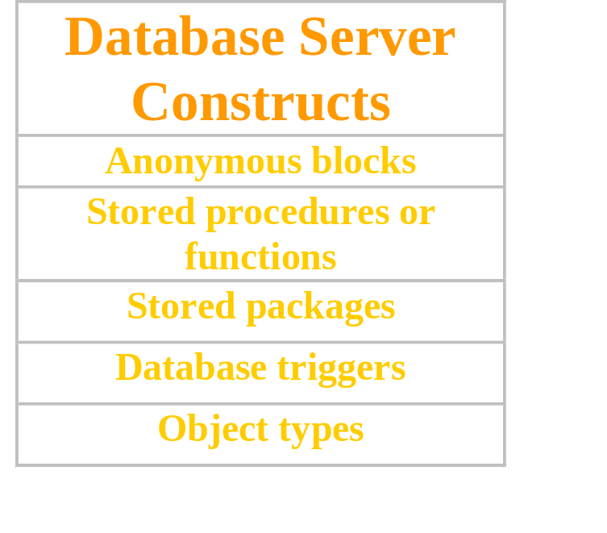
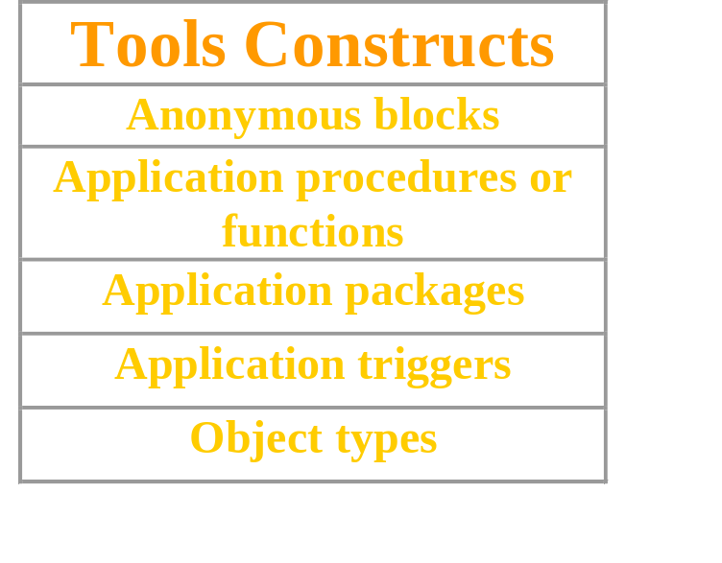
PL/SQL Program Constructs
<header> IS|AS
or DECLARE
BEGIN
EXCEPTION
END;
Notes:
PL/SQL Program Constructs
The diagram above displays a variety of different PL/SQL program constructs using the basic PL/SQL block. In general, a block is either an anonymous block or a named block (subprogram or program unit).
PL/SQL Block Structure
Every PL/SQL construct is composed of one or more blocks. These blocks can be entirely separate or nested within one another. Therefore, one block can represent a small part of another block, which in turn can be part of the whole unit of code.
Note: In the slide, the word "or" prior to the keyword DECLARE is not part of the syntax. It is used in the diagram to differentiate between starting of subprograms and anonymous blocks.
The PL/SQL blocks can be constructed on and use the Oracle server (stored PL/SQL program units). They can also be constructed using the Oracle Developer tools such as Oracle Forms Developer, Oracle Report Developer, and so on (application or client-side PL/SQL program units).
Object types are user-defined composite data types that encapsulates a data structure along with the functions and procedures needed to manipulate the data. You can create object types either on the Oracle server or using the Oracle Developer tools.
In this course, you will learn writing and managing stored procedures and functions, database triggers, and packages. Creating object types is not covered in this course.

Slide 5
Overview of Subprograms
A subprogram:
Is a named PL/SQL block that can accept parameters and be invoked from a calling environment
Is of two types:
  A procedure that performs an action
  A function that computes a value
Is based on standard PL/SQL block structure
Provides modularity, reusability, extensibility,
and maintainability
Provides easy maintenance, improved data security and integrity, improved performance, and improved code clarity
Notes:
Overview of Subprogram
A subprogram is based on standard PL/SQL structure that contains a declarative section, an executable section, and an optional exception-handling section.
A subprogram can be compiled and stored in the database. It provides modularity, extensibility, reusability, and maintainability.
Modularization is the process of breaking up large blocks of code into smaller groups of code called modules. After code is modularized, the modules can be reused by the same program or shared by other programs. It is easier to maintain and debug code of smaller modules than a single large program. Also, the modules can be easily extended for customization by incorporating more functionality, if required, without affecting the remaining modules of the program.
Subprograms provide easy maintenance because the code is located in one place and hence any modifications required to the subprogram can be performed in this single location. Subprograms provide improved data integrity and security. The data objects are accessed through the subprogram and a user can invoke the subprogram only if appropriate access privilege is granted to the user.

Slide 6
Block Structure for Anonymous
PL/SQL Blocks
DECLARE (optional)
    Declare PL/SQL objects to be used
    within this block
BEGIN (mandatory)
    Define the executable statements
EXCEPTION (optional)
    Define the actions that take place if
    an error or exception arises
END; (mandatory)
Notes:
Anonymous Blocks
Anonymous blocks do not have names. You declare them at the point in an application where they are to be run, and they are passed to the PL/SQL engine for execution at run time.
The section between the keywords DECLARE and BEGIN is referred to as the declaration section. In the declaration section, you define the PL/SQL objects such as variables, constants, cursors, and user-defined exceptions that you want to reference within the block. The DECLARE keyword is optional if you do not declare any PL/SQL objects.
The BEGIN and END keywords are mandatory and enclose the body of actions to be performed. This section is referred to as the executable section of the block.
The section between EXCEPTION and END is referred to as the exception section. The exception section traps error conditions. In it, you define actions to take if the specified condition arises. The exception section is optional.
The keywords DECLARE, BEGIN, and EXCEPTION are not followed by semicolons, but END and all other PL/SQL statements do require semicolons.
Instructor Note
DECLARE, BEGIN, EXCEPTION, and END are keywords; the areas between them are sections. The set of PL/SQL statements between BEGIN and END, though it is called a PL/SQL block, actually forms a PL/SQL statement in itself. There can be multiple BEGIN .. END sections in a PL/SQL block.

Slide 7
Block Structure for PL/SQL Subprograms
<header>
IS | AS
Declaration section
BEGIN
Executable section
EXCEPTION (optional)
Exception section
END;
Subprogram Specification
Subprogram Body
Notes:
Subprograms
Subprograms are named PL/SQL blocks that can accept parameters and be invoked from a calling environment. PL/SQL has two types of subprograms, procedures and functions.
Subprogram Specification
The header is relevant for named blocks only and determines the way that the program unit is called or invoked.
The header determines:
The PL/SQL subprogram type, that is, either a procedure or a function
The name of the subprogram
The parameter list, if one exists
The RETURN clause, which applies only to functions
The IS or AS keyword is mandatory.
Subprogram Body
The declaration section of the block between IS|AS and BEGIN. The keyword DECLARE that is used to indicate the starting of the declaration section in anonymous blocks is not used here.
The executable section between the BEGIN and END keywords is mandatory, enclosing the body of actions to be performed. There must be at least one statement existing in this section. There should be atleast a NULL;statement, that is considered an executable statement.
The exception section between EXCEPTION and END is optional. This section traps predefined error conditions. In this section, you define actions to take if the specified error condition arises.

Slide 8
PL/SQL Subprograms
----- --- --- ---
----- --- --- ---
----- --- --- ---
----- --- --- ---
----- --- --- ---
----- --- --- ---
----- --- --- ---
----- --- --- ---
----- --- --- ---
----- --- --- ---
xxx xxx xxx
xxx xxx xxx
----- --- --- ---
----- --- --- ---
----- --- --- ---
----- --- --- ---
----- --- --- ---
----- --- --- ---
----- --- --- ---
----- --- --- ---
P
P
P
xxx xxx xxx
xxx xxx xxx
xxx xxx xxx
xxx xxx xxx
xxx xxx xxx
xxx xxx xxx
Subprogram P,
which contains the
repeated code
PL/SQL program invoking
the subprogram at multiple
locations
Code repeated more than
once in a PL/SQL program
Notes:
Subprograms
The diagram in the slide explains how you can replace a sequence of PL/SQL statements repeated in a PL/SQL block with a subprogram.
When a sequence of statements is repeated more than once in a PL/SQL subprogram, you can create a subprogram with the repeated code. You can invoke the subprogram at multiple locations in a PL/SQL block. After the subprogram is created and stored in the database, it can be invoked any number of times and from multiple applications.
Instructor Note (for page 9-10)
There are two ways to process PL/SQL blocks in iSQL*Plus:
Define a block in the iSQL*Plus buffer from the input window, then run the buffer.
Define a block as part of a SQL script file, load the script into the iSQL*Plus buffer, then run the file.
Demonstration: 09_logexec.sql
Purpose: To show how to create a stored procedure in iSQL*Plus
1. Invoke a iSQL*Plus session.
2. Check whether you have a table called LOG_TABLE; if not, run 09_addtabs.sql. This file adds additional tables necessary for demonstrations in this course.
3. Browse and load the code in the file 09_logexec.sql.
4. Execute the code in iSQL*Plus to create the procedure.
Tell students not to worry about syntax at this stage.

Slide 9
Benefits of Subprograms
Easy maintenance
Improved data security and integrity
Improved performance
Improved code clarity
Notes:
Benefits of Subprograms
Stored procedures and functions have many benefits in addition to modularizing application development:
Easy maintenance
Modify routines online without interfering with other users
Modify one routine to affect multiple applications
Modify one routine to eliminate duplicate testing
Improved data security and integrity
Control indirect access to database objects from nonprivileged users with security privileges
Ensure that related actions are performed together, or not at all, by funneling activity for related tables through a single path
Improved performance
Avoid reparsing for multiple users by exploiting the shared SQL area
Avoid PL/SQL parsing at run time by parsing at compile time
Reduce the number of calls to the database and decrease network traffic by bundling commands
Improved code clarity: Using appropriate identifier names to describe the action of the routines reduces the need for comments and enhances the clarity of the code.

Slide 10
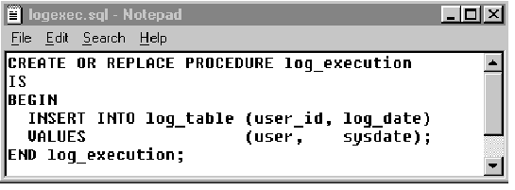
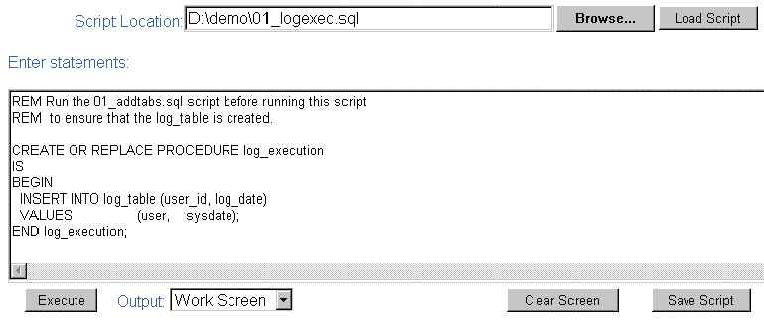
Developing Subprograms by Using iSQL*Plus
1
2
3
4
Notes:
Developing Subprograms by Using iSQL*Plus
iSQL*Plus is an Internet-enabled interface to SQL*Plus. You can use a Web browser to connect to an Oracle database and perform the same actions as you would through other SQL*Plus interfaces.
1. Use a text editor to create a SQL script file to define your subprogram. The example in the slide creates the stored procedure LOG_EXECUTION without any parameters. The procedure records the username and current date in a database table called LOG_TABLE.
From iSQL*Plus browser window:
2. Use the Browse button to locate the SQL script file.
3. Use the Load Script button to load the script into the iSQL*Plus buffer.
4. Use the Execute button to run the code. By default, the output from the code is displayed on the screen.
PL/SQL subprograms can also be created by using the Oracle development tools such as Oracle Forms Developer.

Slide 11



Invoking Stored Procedures and Functions
Scott
LOG_EXECUTION
procedure
1
xxxxxxxxxxxxxx
vvvvvvvvvvvvvv
xxxxxxxxxxxxxx
vvvvvvvvvvvvvv
xxxxxxxxxxxxxx
vvvvvvvvvvvvvv
xxxxxxxxxxxxxx
vvvvvvvvvvvvvv
xxxxxxxxxxxxxx
vvvvvvvvvvvvvv
2
xxxxxxxxxxxxxx
vvvvvvvvvvvvvv
xxxxxxxxxxxxxx
vvvvvvvvvvvvvv
xxxxxxxxxxxxxx
vvvvvvvvvvvvvv
xxxxxxxxxxxxxx
vvvvvvvvvvvvvv
xxxxxxxxxxxxxx
vvvvvvvvvvvvvv
3
Oracle Portal
Oracle Discoverer
Oracle
Forms Developer
4
Scott
Notes:
How to Invoke Stored Procedures and Functions
You can invoke a previously created procedure or function from a variety of environments such as iSQL*Plus, Oracle Forms Developer, Oracle Discoverer, Oracle Portal, another stored procedure, and many other Oracle tools and precompiler applications. The table below describes how you can invoke a previously created procedure, log_execution, from a variety of environments.
Instructor Note
Oracle Portal is an Oracle portal developer tool that was previously known as WebDB.

Slide 12
What Is a Procedure?
A procedure is a type of subprogram that performs an action.
A procedure can be stored in the database, as a schema object, for repeated execution.
Notes:
Definition of a Procedure
A procedure is a named PL/SQL block that can accept parameters (sometimes referred to as arguments), and be invoked. Generally speaking, you use a procedure to perform an action. A procedure has a header, a declaration section, an executable section, and an optional exception-handling section.
A procedure can be compiled and stored in the database as a schema object.
Procedures promote reusability and maintainability. When validated, they can be used in any number of applications. If the requirements change, only the procedure needs to be updated.

Slide 13
Syntax for Creating Procedures
CREATE [OR REPLACE] PROCEDURE procedure_name
[(parameter1 [mode1] datatype1,
parameter2 [mode2] datatype2,
. . .)]
IS|AS
PL/SQL Block;
The REPLACE option indicates that if the procedure exists, it will be dropped and replaced with the new version created by the statement.
PL/SQL block starts with either BEGIN or the declaration of local variables and ends with either END or END procedure_name.
Notes:
Syntax for Creating Procedures
Syntax Definitions
You create new procedures with the CREATE PROCEDURE statement, which may declare a list of parameters and must define the actions to be performed by the standard PL/SQL block. The CREATE clause enables you to create stand-alone procedures, which are stored in an Oracle database.
PL/SQL blocks start with either BEGIN or the declaration of local variables and end with either END or END procedure_name. You cannot reference host or bind variables in the PL/SQL block of a stored procedure.
The REPLACE option indicates that if the procedure exists, it will be dropped and replaced with the new version created by the statement.
You cannot restrict the size of the data type in the parameters.

Slide 14
Developing Procedures
Editor
file.sql
Code to create
procedure
1
iSQL*Plus
2
Load and execute file.sql
Oracle
Source code
Use SHOW ERRORS
to view
compilation errors
Compile
P code
Procedure
created
Execute
3
Notes:
Developing Procedures
Following are the main steps for developing a stored procedure. The next two pages provide more detail about creating procedures.
1. Write the syntax: Enter the code to create a procedure (CREATE PROCEDURE statement) in a system editor or word processor and save it as a SQL script file (.sql extension).
2. Compile the code: Using iSQL*Plus, load and run the SQL script file. The source code is compiled into P code and the procedure is created.
A script file with the CREATE PROCEDURE (or CREATE OR REPLACE PROCEDURE) statement enables you to change the statement if there are any compilation or run-time errors, or to make subsequent changes to the statement. You cannot successfully invoke a procedure that contains any compilation or run-time errors. In iSQL*Plus, use SHOW ERRORS to see any compilation errors. Running the CREATE PROCEDURE statement stores the source code in the data dictionary even if the procedure contains compilation errors. Fix the errors in the code using the editor and recompile the code.
3. Execute the procedure to perform the desired action. After the source code is compiled and the procedure is successfully created, the procedure can be executed any number of times using the EXECUTE command from iSQL*Plus. The PL/SQL compiler generates the pseudocode or P code, based on the parsed code. The PL/SQL engine executes this when the procedure is invoked.
Note: If there are any compilation errors, and you make subsequent changes to the CREATE PROCEDURE statement, you must either DROP the procedure first, or use the OR REPLACE syntax.
You can create client side procedures that are used with client-side applications using tools such as the Oracle Forms and Reports of Oracle integrated development environment (IDE). Refer to Appendix F to see how the client side subprograms can be created using the Oracle Procedure Builder tool.

Slide 15
Formal Versus Actual Parameters
Formal parameters: variables declared in the parameter list of a subprogram specification
Example:
CREATE PROCEDURE raise_sal(p_id NUMBER, p_amount NUMBER)
...
END raise_sal;
Actual parameters: variables or expressions referenced in the parameter list of a subprogram call
Example:
raise_sal(v_id, 2000)
Notes:
Formal Versus Actual Parameters
Formal parameters are variables declared in the parameter list of a subprogram specification. For example, in the procedure RAISE_SAL, the variables P_ID and P_AMOUNT are formal parameters.
Actual parameters are variables or expressions referenced in the parameter list of a subprogram call. For example, in the call raise_sal(v_id , 2000) to the procedure RAISE_SAL, the variable V_ID and 2000 are actual parameters.
Actual parameters are evaluated and results are assigned to formal parameters during the subprogram call.
Actual parameters can also be expressions such as in the following:
raise_sal(v_id, raise+100);
It is good practice to use different names for formal and actual parameters. Formal parameters have the prefix p_ in this course.
The formal and actual parameters should be of compatible data types. If necessary, before assigning the value, PL/SQL converts the data type of the actual parameter value to that of the formal parameter.
Instructor Note
In the slide, the mode is not explicitly specified because the parameter modes are not yet discussed. It defaults to IN mode.

Slide 16
Procedural Parameter Modes
Procedure
Calling
environment
IN parameter
OUT parameter
IN OUT parameter
(DECLARE)
BEGIN
EXCEPTION
END;
Notes:
Procedural Parameter Modes
You can transfer values to and from the calling environment through parameters. Select one of the three modes for each parameter: IN, OUT, or IN OUT.
Attempts to change the value of an IN parameter will result in an error.
Note: DATATYPE can be only the %TYPE definition, the %ROWTYPE definition, or an explicit data type with no size specification.

Slide 17
Creating Procedures with Parameters
IN
OUT
IN OUT
Default mode
Must be specified
Must be specified
Value is passed into subprogram
Returned to calling environment
Passed into subprogram; returned to calling environment
Formal parameter acts as a constant
Uninitialized variable
Initialized variable
Actual parameter can be a literal, expression, constant, or initialized variable
Must be a variable
Must be a variable
Can be assigned a default value
Cannot be assigned
a default value
Cannot be assigned
a default value
Notes:
Creating Procedures with Parameters
When you create the procedure, the formal parameter defines the value used in the executable section of the PL/SQL block, whereas the actual parameter is referenced when invoking the procedure.
The parameter mode IN is the default parameter mode. That is, no mode is specified with a parameter, the parameter is considered an IN parameter. The parameter modes OUT and IN OUT must be explicitly specified in front of such parameters.
A formal parameter of IN mode cannot be assigned a value. That is, an IN parameter cannot be modified in the body of the procedure.
An OUT or IN OUT parameter must be assigned a value before returning to the calling environment.
IN parameters can be assigned a default value in the parameter list. OUT and IN OUT parameters cannot be assigned default values.
By default, the IN parameter is passed by reference and the OUT and IN OUT parameters are passed by value. To improve performance with OUT and IN OUT parameters, the compiler hint NOCOPY can be used to request to pass by reference. Using NOCOPY is discussed in detail in the Advanced PL/SQL course.

Slide 18
IN Parameters: Example
176
p_id
CREATE OR REPLACE PROCEDURE raise_salary
(p_id IN employees.employee_id%TYPE)
IS
BEGIN
UPDATE employees
SET salary = salary * 1.10
WHERE employee_id = p_id;
END raise_salary;
/
Notes:
IN Parameters: Example
The example in the slide shows a procedure with one IN parameter. Running this statement in iSQL*Plus creates the RAISE_SALARY procedure. When invoked, RAISE_SALARY accepts the parameter for the employee ID and updates the employee’s record with a salary increase of 10 percent.
To invoke a procedure in iSQL*Plus, use the EXECUTE command.
EXECUTE raise_salary (176)
To invoke a procedure from another procedure, use a direct call. At the location of calling the new procedure, enter the procedure name and actual parameters.
raise_salary (176);
IN parameters are passed as constants from the calling environment into the procedure. Attempts to change the value of an IN parameter result in an error.
Instructor Note
Remind students that an UPDATE or a DELETE command that does not affect any rows does not generate a run-time error in PL/SQL. Use the cursor attributes SQL%FOUND, SQL%NOTFOUND, and SQL%ROWCOUNT to test the outcome of these data manipulation language statements.
The EXECUTE command given at the iSQL*Plus input window invokes Oracle Call Interface (OCI) calls that embed the statement inside an anonymous block and send it to the server to be processed, bypassing the SQL buffer. The EXECUTE command invoking the RAISE_SALARY procedure is sent to the server as BEGIN raise_salary(176); END;

Slide 19
OUT Parameters: Example
Calling environment
QUERY_EMP procedure
171
p_id
SMITH
p_name
7400
p_salary
0.15
p_comm
Notes:
OUT Parameters: Example
In this example, you create a procedure with OUT parameters to retrieve information about an employee. The procedure accepts a value 171 for employee ID and retrieves the name, salary, and commission percentage of the employee with ID 171 into the three output parameters. The code to create the QUERY_EMP procedure is shown in the next slide.

Slide 20
OUT Parameters: Example
emp_query.sql
CREATE OR REPLACE PROCEDURE query_emp
(p_id IN employees.employee_id%TYPE,
p_name OUT employees.last_name%TYPE,
p_salary OUT employees.salary%TYPE,
p_comm OUT employees.commission_pct%TYPE)
IS
BEGIN
SELECT last_name, salary, commission_pct
INTO p_name, p_salary, p_comm
FROM employees
WHERE employee_id = p_id;
END query_emp;
/
Notes:
OUT Parameters: Example (continued)
Run the script file shown in the slide to create the QUERY_EMP procedure. This procedure has four formal parameters. Three of them are OUT parameters that return values to the calling environment.
The procedure accepts an EMPLOYEE_ID value for the parameter P_ID. The name, salary, and commission percentage values corresponding to the employee ID are retrieved into the three OUT parameters whose values are returned to the calling environment.
Notice that the name of the script file need not be the same as the procedure name. (The script file is on the client side and the procedure is being stored on the database schema.)

Slide 21

Viewing OUT Parameters
Load and run the emp_query.sql script file to create the QUERY_EMP procedure.
Declare host variables, execute the QUERY_EMP procedure, and print the value of the global G_NAME variable.
VARIABLE g_name VARCHAR2(25)
VARIABLE g_sal NUMBER
VARIABLE g_comm NUMBER
EXECUTE query_emp(171, :g_name, :g_sal, :g_comm)
PRINT g_name
Notes:
How to View the Value of OUT Parameters with iSQL*Plus
1. Run the SQL script file to generate and compile the source code.
2. Create host variables in iSQL*Plus, using the VARIABLE command.
3. Invoke the QUERY_EMP procedure, supplying these host variables as the OUT parameters. Note the use of the colon (:) to reference the host variables in the EXECUTE command.
4. To view the values passed from the procedure to the calling environment, use the PRINT command.
The example in the slide shows the value of the G_NAME variable passed back to the the calling environment. The other variables can be viewed, either individually, as above, or with a single PRINT command.
PRINT g_name g_sal g_comm
Do not specify a size for a host variable of data type NUMBER when using the VARIABLE command. A host variable of data type CHAR or VARCHAR2 defaults to a length of one, unless a value is supplied in parentheses.
PRINT and VARIABLE are iSQL*Plus commands.
Note: Passing a constant or expression as an actual parameter to the OUT variable causes compilation errors. For example:
EXECUTE query_emp(171, :g_name, raise+100, :g_comm)
causes a compilation error.
Instructor Note
A iSQL*Plus host variable of the data type VARCHAR2 defaults to a length of one when no length is specified. Make sure your host variables can hold the values of the parameters. Remind the students that formal parameters should not be constrained in length.

Slide 22
IN OUT Parameters
Calling environment
FORMAT_PHONE procedure
'8006330575'
'(800)633-0575'
p_phone_no
CREATE OR REPLACE PROCEDURE format_phone
(p_phone_no IN OUT VARCHAR2)
IS
BEGIN
p_phone_no := '(' || SUBSTR(p_phone_no,1,3) ||
')' || SUBSTR(p_phone_no,4,3) ||
'-' || SUBSTR(p_phone_no,7);
END format_phone;
/
Notes:
Using IN OUT Parameters
With an IN OUT parameter, you can pass values into a procedure and return a value to the calling environment. The value that is returned is either the original, an unchanged value, or a new value set within the procedure.
An IN OUT parameter acts as an initialized variable.
Example
Create a procedure with an IN OUT parameter to accept a character string containing 10 digits and return a phone number formatted as (800) 633-0575.
Run the statement to create the FORMAT_PHONE procedure.

Slide 23
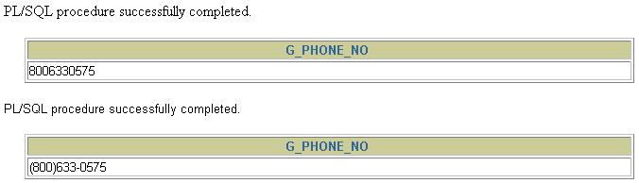
Viewing IN OUT Parameters
VARIABLE g_phone_no VARCHAR2(15)
BEGIN
:g_phone_no := '8006330575';
END;
/
PRINT g_phone_no
EXECUTE format_phone (:g_phone_no)
PRINT g_phone_no
Notes:
How to View IN OUT Parameters with iSQL*Plus
1. Create a host variable, using the VARIABLE command.
2. Populate the host variable with a value, using an anonymous PL/SQL block.
3. Invoke the FORMAT_PHONE procedure, supplying the host variable as the IN OUT parameter. Note the use of the colon (:) to reference the host variable in the EXECUTE command.
4. To view the value passed back to the calling environment, use the PRINT command.

Slide 24
Methods for Passing Parameters
Positional: List actual parameters in the same order as formal parameters.
Named: List actual parameters in arbitrary order by associating each with its corresponding formal parameter.
Combination: List some of the actual parameters as positional and some as named.
Notes:
Parameter Passing Methods
For a procedure that contains multiple parameters, you can use a number of methods to specify the values of the parameters.

Slide 25
DEFAULT Option for Parameters
CREATE OR REPLACE PROCEDURE add_dept
(p_name IN departments.department_name%TYPE
DEFAULT 'unknown',
p_loc IN departments.location_id%TYPE
DEFAULT 1700)
IS
BEGIN
INSERT INTO departments(department_id,
department_name, location_id)
VALUES (departments_seq.NEXTVAL, p_name, p_loc);
END add_dept;
/
Notes:
Example of Default Values for Parameters
You can initialize IN parameters to default values. That way, you can pass different numbers of actual parameters to a subprogram, accepting or overriding the default values as you please. Moreover, you can add new formal parameters without having to change every call to the subprogram.
Execute the statement in the slide to create the ADD_DEPT procedure. Note the use of the DEFAULT clause in the declaration of the formal parameter.
You can assign default values only to parameters of the IN mode. OUT and IN OUT parameters are not permitted to have default values. If default values are passed to these types of parameters, you get the following compilation error:
PLS-00230: OUT and IN OUT formal parameters may not have default expressions
If an actual parameter is not passed, the default value of its corresponding formal parameter is used. Consider the calls to the above procedure that are depicted in the next page.

Slide 26
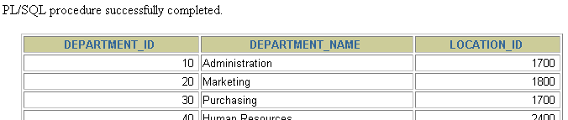
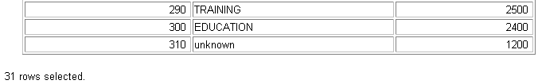
Examples of Passing Parameters
BEGIN
add_dept;
add_dept ('TRAINING', 2500);
add_dept ( p_loc => 2400, p_name =>'EDUCATION');
add_dept ( p_loc => 1200) ;
END;
/
SELECT department_id, department_name, location_id
FROM departments;
…
Notes:
Example of Default Values for Parameters (continued)
The anonymous block above shows the different ways the ADD_DEPT procedure can be invoked, and the output of each way the procedure is invoked.
Usually, you can use positional notation to override the default values of formal parameters. However, you cannot skip a formal parameter by leaving out its actual parameter.
Note: All the positional parameters should precede the named parameters in a subprogram call. Otherwise, you will receive an error message, as shown in the following example:
EXECUTE add_dept(p_name=>'new dept', 'new location')
Instructor Note
Line 2: Works because the formal parameters have a default value
Line 3: Uses a positional reference
Line 4: Uses a named association
Line 5: Uses the default value for the department name and named association for the location

Slide 27
Declaring Subprograms
leave_emp2.sql
CREATE OR REPLACE PROCEDURE leave_emp2
(p_id IN employees.employee_id%TYPE)
IS
PROCEDURE log_exec
IS
BEGIN
INSERT INTO log_table (user_id, log_date)
VALUES (USER, SYSDATE);
END log_exec;
BEGIN
DELETE FROM employees
WHERE employee_id = p_id;
log_exec;
END leave_emp2;
/
Notes:
Declaring Subprograms
You can declare subprograms in any PL/SQL block. This is an alternative to creating the stand-alone procedure LOG_EXEC. Subprograms declared in this manner are called local subprograms (or local modules). Because they are defined within a declaration section of another program, the scope of local subprograms is limited to the parent (enclosing) block in which they are defined. This means that local subprograms cannot be called from outside the block in which they are declared. Declaring local subprograms enhances the clarity of the code by assigning appropriate business-rule identifiers to blocks of code.
Note: You must declare the subprogram in the declaration section of the block, and it must be the last item, after all the other program items. For example, a variable declared after the end of the subprogram, before the BEGIN of the procedure, will cause a compilation error.
If the code must be accessed by multiple applications, place the subprogram in a package or create a stand-alone subprogram with the code. Packages are discussed later in this course.
Instructor Note
The developer can choose whether to implement the method shown in the slide, or create a stand-alone procedure called LOG_EXEC. Declaring a subprogram within a procedure keeps the nested procedure private to the calling procedure.
Ensure that the students are aware that this is primarily for their information and that an alternative method to keep procedures private is to use packages, which are covered later in this course. Local subprograms can be overloaded. Overloading is discussed later in this course.

Slide 28
Invoking a Procedure from an Anonymous PL/SQL Block
DECLARE
v_id NUMBER := 163;
BEGIN
raise_salary(v_id); --invoke procedure
COMMIT;
...
END;
Notes:
Invoking a Procedure from an Anonymous PL/SQL Block
Invoke the RAISE_SALARY procedure from an anonymous PL/SQL block, as shown in the slide.
Procedures are callable from any tool or language that supports PL/SQL.
You have already seen how to invoke an independent procedure from iSQL*Plus.
Instructor Note
The RAISE_SALARY procedure is shown earlier in this lesson.

Slide 29
Invoking a Procedure from Another Procedure
process_emps.sql
CREATE OR REPLACE PROCEDURE process_emps
IS
CURSOR emp_cursor IS
SELECT employee_id
FROM employees;
BEGIN
FOR emp_rec IN emp_cursor
LOOP
raise_salary(emp_rec.employee_id);
END LOOP;
COMMIT;
END process_emps;
/
Notes:
Invoking a Procedure from Another Procedure
This example shows you how to invoke a procedure from another stored procedure. The PROCESS_EMPS stored procedure uses a cursor to process all the records in the EMPLOYEES table and passes each employee’s ID to the RAISE_SALARY procedure, which results in a 10 percent salary increase across the company.
Instructor Note
RAISE_SALARY is shown earlier in the lesson.
The code example script does not contain the COMMIT.

Slide 30
Handled Exceptions
Called procedure
Calling procedure
PROCEDURE
PROC2 ...
IS
...
BEGIN
...
EXCEPTION
...
END PROC2;
PROCEDURE
PROC1 ...
IS
...
BEGIN
...
PROC2(arg1);
...
EXCEPTION
...
END PROC1;
Exception raised
Exception handled
Control returns to calling procedure
Notes:
How Handled Exceptions Affect the Calling Procedure
When you develop procedures that are called from other procedures, you should be aware of the effects that handled and unhandled exceptions have on the transaction and the calling procedure.
When an exception is raised in a called procedure, control immediately goes to the exception section of that block. If the exception is handled, the block terminates, and control goes to the calling program. Any data manipulation language (DML) statements issued before the exception was raised remain as part of the transaction.

Slide 31
Handled Exceptions
CREATE PROCEDURE p2_ins_dept(p_locid NUMBER) IS
v_did NUMBER(4);
BEGIN
DBMS_OUTPUT.PUT_LINE('Procedure p2_ins_dept started');
INSERT INTO departments VALUES (5, 'Dept 5', 145, p_locid);
SELECT department_id INTO v_did FROM employees
WHERE employee_id = 999;
END;
CREATE PROCEDURE p1_ins_loc(p_lid NUMBER, p_city VARCHAR2)
IS
v_city VARCHAR2(30); v_dname VARCHAR2(30);
BEGIN
DBMS_OUTPUT.PUT_LINE('Main Procedure p1_ins_loc');
INSERT INTO locations (location_id, city) VALUES (p_lid, p_city);
SELECT city INTO v_city FROM locations WHERE location_id = p_lid;
DBMS_OUTPUT.PUT_LINE('Inserted city '||v_city);
DBMS_OUTPUT.PUT_LINE('Invoking the procedure p2_ins_dept ...');
p2_ins_dept(p_lid);
EXCEPTION
WHEN NO_DATA_FOUND THEN
DBMS_OUTPUT.PUT_LINE('No such dept/loc for any employee');
END;
Notes:
How Handled Exceptions Affect the Calling Procedure (continued)
The example in the slide shows two procedures. Procedure P1_INS_LOC inserts a new location (supplied through the parameters) into the LOCATIONS table. Procedure P2_INS_DEPT inserts a new department (with department ID 5) at the new location inserted through the P1_INS_LOC procedure. The P1_INS_LOC procedure invokes the P2_INS_DEPT procedure.
The P2_INS_DEPT procedure has a SELECT statement that selects DEPARTMENT_ID for a nonexisting employee and raises a NO_DATA_FOUND exception. Because this exception is not handled in the P2_INS_DEPT procedure, the control returns to the calling procedure P1_INS_LOC where the exception is handled. As the exception is handled, the DML in the P2_INS_DEPT procedure is not rolled back and is part of the transaction of the P1_INS_LOC procedure.
The following code shows that the INSERT statements from both the procedures are successful:
EXECUTE p1_ins_loc(1, 'Redwood Shores')
SELECT location_id, city FROM locations
WHERE location_id = 1;
SELECT * FROM departments WHERE department_id = 5;

Slide 32
Unhandled Exceptions
Called procedure
Calling procedure
PROCEDURE
PROC2 ...
IS
...
BEGIN
...
EXCEPTION
...
END PROC2;
PROCEDURE
PROC1 ...
IS
...
BEGIN
...
PROC2(arg1);
...
EXCEPTION
...
END PROC1;
Exception raised
Exception unhandled
Control returned to exception section of calling procedure
Notes:
How Unhandled Exceptions Affect the Calling Procedure
When an exception is raised in a called procedure, control immediately goes to the exception section of that block. If the exception is unhandled, the block terminates, and control goes to the exception section of the calling procedure. PL/SQL does not roll back database work that is done by the subprogram.
If the exception is handled in the calling procedure, all DML statements in the calling procedure and in the called procedure remain as part of the transaction.
If the exception is unhandled in the calling procedure, the calling procedure terminates and the exception propagates to the calling environment. All the DML statements in the calling procedure and the called procedure are rolled back along with any changes to any host variables. The host environment determines the outcome for the unhandled exception.

Slide 33
Unhandled Exceptions
CREATE PROCEDURE p2_noexcep(p_locid NUMBER) IS
v_did NUMBER(4);
BEGIN
DBMS_OUTPUT.PUT_LINE('Procedure p2_noexcep started');
INSERT INTO departments VALUES (6, 'Dept 6', 145, p_locid);
SELECT department_id INTO v_did FROM employees
WHERE employee_id = 999;
END;
CREATE PROCEDURE p1_noexcep(p_lid NUMBER, p_city VARCHAR2)
IS
v_city VARCHAR2(30); v_dname VARCHAR2(30);
BEGIN
DBMS_OUTPUT.PUT_LINE(' Main Procedure p1_noexcep');
INSERT INTO locations (location_id, city) VALUES (p_lid, p_city);
SELECT city INTO v_city FROM locations WHERE location_id = p_lid;
DBMS_OUTPUT.PUT_LINE('Inserted new city '||v_city);
DBMS_OUTPUT.PUT_LINE('Invoking the procedure p2_noexcep ...');
p2_noexcep(p_lid);
END;
Notes:
How Unhandled Exceptions Affect the Calling Procedure (continued)
The example in the slide shows two procedures. Procedure P1_NOEXCEP inserts a new location (supplied through the parameters) into the LOCATIONS table. Procedure P2_NOEXCEP inserts a new department (with department ID 5) at the new location inserted through the P1_NOEXCEP procedure. Procedure P1_NOEXCEP invokes the P2_NOEXCEP procedure.
The P2_NOEXCEP procedure has a SELECT statement that selects DEPARTMENT_ID for a nonexisting employee and raises a NO_DATA_FOUND exception. Because this exception is not handled in the P2_NOEXCEP procedure, the control returns to the calling procedure P1_NOEXCEP. The exception is not handled. Because the exception is not handled, the DML in the P2_NOEXCEP procedure is rolled back along with the transaction of the P1_NOEXCEP procedure.
The following code shows that the DML statements from both the procedures are unsuccessful.
EXECUTE p1_noexcep(3, 'New Delhi')
SELECT location_id, city FROM locations
WHERE location_id = 3;
SELECT * FROM departments WHERE department_id = 6;

Slide 34
Removing Procedures
Drop a procedure stored in the database.
  Syntax:
  Example:
DROP PROCEDURE procedure_name
DROP PROCEDURE raise_salary;
Notes:
Removing Procedures
When a stored procedure is no longer required, you can use a SQL statement to drop it.
To remove a server-side procedure by using iSQL*Plus, execute the SQL command DROP PROCEDURE.
Issuing rollback does not have an effect after executing a data definition language (DDL) command such as DROP PROCEDURE, which commits any pending transactions.

Slide 35
Summary
In this lesson, you should have learned that:
A procedure is a subprogram that performs an action.
You create procedures by using the CREATE PROCEDURE command.
You can compile and save a procedure in the database.
Parameters are used to pass data from the calling environment to the procedure.
There are three parameter modes: IN, OUT, and IN OUT.
Notes:
Summary
A procedure is a subprogram that performs a specified action. You can compile and save a procedure as stored procedure in the database. A procedure can return zero or more values through its parameters to its calling environment. There are three parameter modes IN, OUT, and IN OUT.

Slide 36
Summary
Local subprograms are programs that are defined within the declaration section of another program.
Procedures can be invoked from any tool or language that supports PL/SQL.
You should be aware of the effect of handled and unhandled exceptions on transactions and calling procedures.
You can remove procedures from the database by using the DROP PROCEDURE command.
Procedures can serve as building blocks for an application.
Notes:
Summary (continued)
Subprograms that are defined within the declaration section of another program are called local subprograms. The scope of the local subprograms is the program unit within which it is defined.
You should be aware of the effect of handled and unhandled exceptions on transactions and calling procedures. The exceptions are handled in the exception section of a subprogram.
You can modify and remove procedures. You can also create client-side procedures that can be used by client-side applications.

Slide 37
Practice 9 Overview
This practice covers the following topics:
Creating stored procedures to:
  Insert new rows into a table, using the supplied parameter values
  Update data in a table for rows matching with the supplied parameter values
  Delete rows from a table that match the supplied parameter values
  Query a table and retrieve data based on supplied parameter values
Handling exceptions in procedures
Compiling and invoking procedures
Notes:
Practice 9 Overview
In this practice you create procedures that issue DML and query commands.
If you encounter compilation errors when you are using iSQL*Plus, use the SHOW ERRORS command. Using the SHOW ERRORS command is discussed in detail in the Managing Subprograms lesson.
If you correct any compilation errors in iSQL*Plus, do so in the original script file, not in the buffer, and then rerun the new version of the file. This will save a new version of the procedure to the data dictionary.
Instructor Note
Practice Timing: 60 minutes
Included with the course materials is an Additional Practices volume. This is an appropriate time to introduce that volume. Students can complete Additional Practices 15–19 following this lesson.

Slide 38
Notes:
Practice 9
Note: You can find table descriptions and sample data in Appendix D “Table Descriptions and Data.”
Save your subprograms as .sql files, using the Save Script button.
Remember to set the SERVEROUTPUT ON if you set it off previously.
1. Create and invoke the ADD_JOB procedure and consider the results.
a. Create a procedure called ADD_JOB to insert a new job into the JOBS table. Provide the ID and title of the job, using two parameters.
b. Compile the code, and invoke the procedure with IT_DBA as job ID and Database Administrator as job title. Query the JOBS table to view the results.
c. Invoke your procedure again, passing a job ID of ST_MAN and a job title of Stock Manager. What happens and why?
___________________________________________________________________
___________________________________________________________________
2. Create a procedure called UPD_JOB to modify a job in the JOBS table.
a. Create a procedure called UPD_JOB to update the job title. Provide the job ID and a new title, using two parameters. Include the necessary exception handling if no update occurs.
b. Compile the code; invoke the procedure to change the job title of the job ID IT_DBA to Data Administrator. Query the JOBS table to view the results.
Also check the exception handling by trying to update a job that does not exist (you can use job ID IT_WEB and job title Web Master).
3. Create a procedure called DEL_JOB to delete a job from the JOBS table.
a. Create a procedure called DEL_JOB to delete a job. Include the necessary exception handling if no job is deleted.
b. Compile the code; invoke the procedure using job ID IT_DBA. Query the JOBS table to view the results.
Also, check the exception handling by trying to delete a job that does not exist (use job ID IT_WEB). You should get the message you used in the exception-handling section of the procedure as output.

Slide 39
Notes:
Practice 9 (continued)
4. Create a procedure called QUERY_EMP to query the EMPLOYEES table, retrieving the salary and job ID for an employee when provided with the employee ID.
a. Create a procedure that returns a value from the SALARY and JOB_ID columns for a specified employee ID.
Use host variables for the two OUT parameters salary and job ID.
b. Compile the code, invoke the procedure to display the salary and job ID for employee ID 120.
c. Invoke the procedure again, passing an EMPLOYEE_ID of 300. What happens and why?
___________________________________________________________________
___________________________________________________________________

